Slide 1
Case Study: Image Restoration in Medical Imaging
Introduction
Definition of Image Restoration: Image restoration is the process of improving the quality of an image by removing or reducing degradations such as noise, blur, and artifacts. The primary objective is to reconstruct an image that is as close as possible to its original, undistorted state. This involves mathematical modeling and algorithms to reverse the effects of degradation introduced during image acquisition, transmission, or storage.
Importance in Medical Imaging:
Enhancing Diagnostic Accuracy: Clear and high-quality images are crucial for accurate diagnosis and treatment planning in medical applications.
Noise Reduction: Techniques such as denoising help in reducing random variations in intensity caused by low-dose imaging systems, ensuring that critical details are preserved.
Artifact Correction: Artifacts introduced by motion, equipment limitations, or other external factors can obscure (unclear) important diagnostic features, and their removal ensures better interpretability.
Improving Visualization: Enhanced images enable better visualization of anatomical structures, aiding in surgical planning and follow-up assessments.

Slide 2
Common Challenges:
Noise: Random fluctuations in image intensity, commonly seen in low-dose CT scans and MRI, can obscure fine details and make diagnosis challenging.
Blur: Caused by motion during image acquisition or limitations in the imaging device’s resolution, blurring can lead to loss of critical details.
Artifacts: Distortions such as streaks, rings, or shadows may arise due to equipment malfunctions, improper calibration, or patient movement, complicating the interpretation of images.
Applications
Denoising low-dose CT scans.
Motion artifact correction in MRIs.
Enhancement of old X-ray images.
Techniques
Filtering methods: Gaussian, Median, and Wiener filters.
Deep learning: Autoencoders, GANs for image reconstruction.
Example algorithms: U-Net for noise removal - The U-Net architecture is widely used for image segmentation and restoration tasks, including noise removal in medical images.

Slide 3
Example demonstrating image restoration in medical imaging using a Gaussian filter to reduce noise in a noisy medical image
import cv2
import numpy as np
import matplotlib.pyplot as plt
# Load a sample medical image (grayscale)
# Replace 'medical_image.jpg' with the path to your image
image = cv2.imread('medical_image.jpg', cv2.IMREAD_GRAYSCALE)
if image is None:
raise FileNotFoundError("Image not found. Please provide a valid file path.")
# Simulate noise in the image
noisy_image = image + np.random.normal(loc=0, scale=25, size=image.shape).astype(np.uint8)
# Apply Gaussian filter for denoising
denoised_image = cv2.GaussianBlur(noisy_image, (5, 5), 0)

Slide 4
# Plot the original, noisy, and restored images
plt.figure(figsize=(12, 8))
plt.subplot(1, 3, 1)
plt.title("Original Image")
plt.imshow(image, cmap='gray')
plt.axis('off')
plt.subplot(1, 3, 2)
plt.title("Noisy Image")
plt.imshow(noisy_image, cmap='gray')
plt.axis('off')
plt.subplot(1, 3, 3)
plt.title("Restored Image (Gaussian Filter)")
plt.imshow(denoised_image, cmap='gray')
plt.axis('off')
plt.tight_layout()
plt.show()

Slide 5
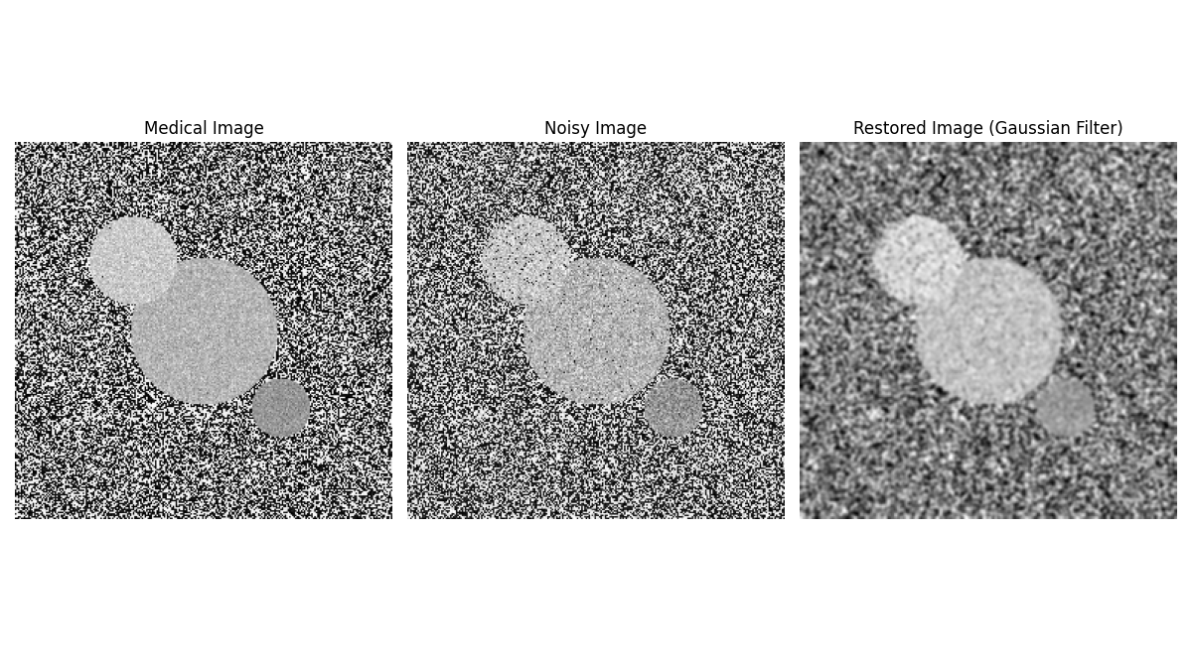

Slide 6
Case Study: Object Detection in Computer Vision
Introduction
Definition: Identifying objects in an image with bounding boxes or Object detection is a computer vision technique that identifies and localizes objects within an image or video. The process involves two key tasks:
Classification: Determining the type or category of objects present (e.g., "car," "person," "dog").
Localization: Marking the exact location of objects in the image using bounding boxes, which are rectangular frames enclosing the objects.
For example, in an image containing a street scene, object detection might identify cars, pedestrians, and traffic lights, while also specifying their positions in the image.
Applications
Self-driving cars: Pedestrian and traffic sign detection.
Retail: Shelf monitoring and product recognition.
Healthcare: Tumor localization in medical images.

Slide 7
Importance of Object Detection
Object detection plays a critical role in a wide range of applications, enhancing the capabilities of machines to perceive, understand, and interact with their surroundings. Below are some of the primary areas where object detection is essential:
Surveillance and Security
Role: Automates the detection of suspicious activities, unauthorized access, or specific objects of interest in surveillance systems.
Examples:
Detecting intruders in restricted zones.
Identifying dangerous objects like weapons in public spaces using CCTV footage.
Benefits: Enhances security, reduces human monitoring efforts, and enables real-time threat detection.
Robotics and Automation
Role: Enables robots to recognize and interact with objects in their environment for navigation, manipulation, or task execution.
Examples:
Industrial robots identifying tools or components on an assembly line.
Home robots detecting and categorizing items for cleaning or organizing.
Benefits: Improves efficiency and accuracy in automated tasks while expanding the scope of robotics.

Slide 8
Autonomous Systems
Role: A fundamental technology for autonomous vehicles, drones, and smart systems, enabling them to navigate and make decisions based on environmental observations.
Examples:
Self-Driving Cars:
Detecting pedestrians, other vehicles, traffic signs, and obstacles to ensure safe navigation.
Drones:
Identifying landmarks for accurate delivery or monitoring purposes.
Benefits: Improves safety, enhances user trust, and facilitates the adoption of intelligent transportation systems.
Retail and Inventory Management
Role: Streamlines inventory tracking and shelf monitoring by detecting and categorizing products.
Examples:
Automated checkout systems recognizing items without barcodes.
Real-time stock updates through shelf-scanning robots.
Benefits: Reduces human errors and improves operational efficiency.

Slide 9
Medical Imaging and Diagnostics
Role: Identifies specific regions of interest within medical images for diagnosis and analysis.
Examples:
Detecting tumors in X-rays or CT scans.
Highlighting fractures or abnormalities in radiological images.
Benefits: Enhances diagnostic precision and supports healthcare professionals in decision-making.
E-commerce and Visual Search
Role: Powers visual search engines and recommendation systems by detecting and recognizing products within images or videos.
Examples:
Suggesting similar items based on a customer’s photo upload.
Benefits: Improves customer experience and increases conversion rates.
Entertainment and Media
Role: Enables applications like augmented reality (AR) and video editing by identifying objects in real-time.
Examples:
AR games that interact with real-world objects.
Video analysis tools for content moderation.
Benefits: Enhances interactivity and provides innovative user experiences.
object detection is a cornerstone of computer vision technology. Its ability to classify and localize objects in images or videos has revolutionized multiple industries, paving the way for smarter, more responsive systems.

Slide 10
Techniques
Traditional: HOG + SVM.
Deep learning: YOLO, SSD, Faster R-CNN.
Key components: Feature extraction, classification, and localization.
Challenges
Variations in object size, occlusion, and lighting.
High computational costs for real-time systems.

Slide 11
Example demonstrating to detects objects in an image using a pre-trained YOLOv5 model
# Import required libraries
from ultralytics import YOLO
import cv2
import matplotlib.pyplot as plt
# Load the pre-trained YOLOv8 model
model = YOLO("yolov8s.pt") # Ensure the model file exists
# Load an image
image_path = r"E:\Bharti\DIP & A IInd Sem\Object Detection in Computer Vision Image.jpg" # Correct path
image = cv2.imread(image_path)
# Check if the image is loaded
if image is None:
print("Error: Unable to load the image. Check the file path.")
exit()
# Perform object detection
results = model.predict(image)
# Annotate the detected objects
annotated_image = results[0].plot()

Slide 12
# Save the annotated image
output_path = r"E:\Bharti\DIP & A IInd Sem\output.jpg" # Save in the correct location
cv2.imwrite(output_path, annotated_image)
print(f"Annotated image saved at {output_path}")
# Display the original and detected images side by side
plt.figure(figsize=(12, 6))
# Original Image
plt.subplot(1, 2, 1)
plt.imshow(cv2.cvtColor(image, cv2.COLOR_BGR2RGB))
plt.axis("off")
plt.title("Original Image")
# Object Detection Output
plt.subplot(1, 2, 2)
plt.imshow(cv2.cvtColor(annotated_image, cv2.COLOR_BGR2RGB))
plt.axis("off")
plt.title("Object Detection Output")
plt.show()

Slide 13
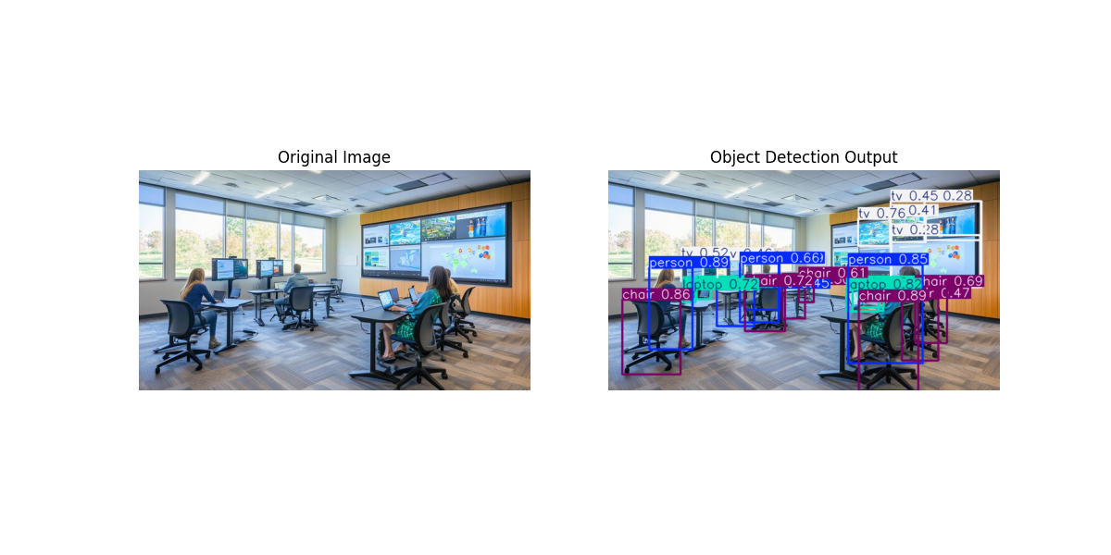

Slide 14
Case Study: Facial Recognition and Biometrics
Introduction to Facial Recognition and Biometrics
Overview of Facial Recognition
Facial recognition is a biometric technology that identifies or verifies individuals by analyzing and comparing facial features. It is a widely used technique in various security and authentication applications, including surveillance, access control, and identity verification. The system captures an image or video of a face, extracts distinctive features such as eye distance, nose shape, and jawline, and then matches them against a database of known faces.
Facial recognition operates through several key steps:
Face Detection – Locating faces in an image or video.
Feature Extraction – Identifying unique characteristics of a face.
Face Matching – Comparing extracted features with stored facial data.
Identity Confirmation – Determining a match based on a similarity threshold.
Modern facial recognition systems employ deep learning techniques, such as Convolutional Neural Networks (CNNs), to enhance accuracy and robustness. Algorithms like FaceNet, DeepFace, and OpenFace provide advanced feature extraction and matching capabilities.

Slide 15
Biometrics: Physiological and Behavioral
Biometrics refers to the measurement and statistical analysis of people’s unique physical and behavioral characteristics. It is used for identity verification in various applications such as mobile authentication, law enforcement, and secure access control.
Physiological Biometrics
These biometric traits are based on a person’s unique physical characteristics. Some common types include:
Facial Recognition – Analyzing facial structure and features.
Iris Recognition – Capturing the unique patterns in the iris of an eye.
Fingerprint Recognition – Matching unique fingerprint ridges and patterns.
Retina Scanning – Examining the blood vessel pattern in the retina.
Hand Geometry – Measuring the shape and structure of a hand.
2. Behavioral Biometrics
Behavioral biometrics focus on unique patterns of human actions and interactions. These include:
Voice Recognition – Identifying individuals based on voice tone, pitch, and speech patterns.
Keystroke Dynamics – Analyzing typing rhythm and speed.
Gait Recognition – Identifying individuals by their walking style.
Signature Recognition – Verifying identity based on handwriting and signature patterns.

Slide 16
Importance of Facial Recognition in Biometrics
Facial recognition is one of the most widely used biometric techniques due to its non-intrusiveness, speed, and ease of implementation. Unlike fingerprint or iris scanning, facial recognition does not require direct contact, making it more user-friendly. Some key applications include:
Security & Law Enforcement – Used for surveillance, suspect identification, and border control.
Smartphones & Devices – Face unlock features in smartphones and laptops.
Banking & Payments – Secure authentication for transactions.
Healthcare – Patient identification in hospitals and clinics.
Retail & Marketing – Personalized customer experiences and automated checkouts.
Challenges in Facial Recognition
Despite its advantages, facial recognition technology faces several challenges:
Lighting and Pose Variations – Performance can degrade in poor lighting or when the face is partially obscured.
Aging and Facial Changes – Faces change over time due to aging, weight loss, or medical conditions.
Privacy Concerns – Unauthorized surveillance and data misuse raise ethical concerns.
Bias and Accuracy Issues – Some facial recognition systems show bias based on race, gender, or ethnicity.
Facial recognition, as a part of biometric technology, is revolutionizing identity verification and security systems. While it offers numerous benefits, ongoing research and advancements in AI are necessary to improve accuracy, reduce bias, and address privacy concerns. With the integration of deep learning and AI-driven models, facial recognition is set to become even more accurate and secure in the future.

Slide 17
Applications
Security: Access control and surveillance.
Consumer tech: Smartphone unlocking.
Healthcare: Patient identification.
Techniques
Feature-based: Eigenfaces, Fisherfaces.
Deep learning: FaceNet, DeepFace, ArcFace.
Method: DeepFace for real-time detection.
Results: Increased security and reduced manual checks.
Ethical Concerns
Privacy issues.
Bias in datasets leading to inaccuracies.

Slide 18
Example Demonstrating Face Detection and Recognition Using Pre-trained Facial Embedding Model
import cv2
import face_recognition
import numpy as np
# Load known face
known_image_path = r"E:\Bharti\DIP & A IInd Sem\APJ.jfif"
known_image = face_recognition.load_image_file(known_image_path)
# Get face encodings
known_encodings = face_recognition.face_encodings(known_image)
# Check if face is detected
if len(known_encodings) == 0:
print("No face detected in the known image. Try another image.")
else:
known_encoding = known_encodings[0]
# Load the group image (test image)
test_image_path = r"E:\Bharti\DIP & A IInd Sem\Facial recognition and biometrics Image.jfif"
test_image = face_recognition.load_image_file(test_image_path)

Slide 19
# Convert images for OpenCV display
known_image_bgr = cv2.cvtColor(known_image, cv2.COLOR_RGB2BGR)
original_group_image = cv2.cvtColor(test_image, cv2.COLOR_RGB2BGR)
# Detect faces in the group image
face_locations = face_recognition.face_locations(test_image)
face_encodings = face_recognition.face_encodings(test_image, face_locations)
for (top, right, bottom, left), face_encoding in zip(face_locations, face_encodings):
matches = face_recognition.compare_faces([known_encoding], face_encoding)
name = "Unknown"
if True in matches:
name = "Dr. APJ Abdul Kalam"
# Draw a box around each detected face
cv2.rectangle(test_image, (left, top), (right, bottom), (0, 255, 0), 3)
# Adjust text position to avoid overlap
font_scale = max((right - left) / 300, 0.6) # Dynamic scaling
thickness = 2
text_size = cv2.getTextSize(name, cv2.FONT_HERSHEY_SIMPLEX, font_scale, thickness)[0]

Slide 20
# Position text dynamically based on available space
text_x = left
text_y = top - 15 if top - 15 > text_size[1] else bottom + text_size[1] + 5
# Ensure text doesn't go beyond image height
text_y = min(text_y, test_image.shape[0] - 10)
# Put full name text
cv2.putText(test_image, name, (text_x, text_y), cv2.FONT_HERSHEY_SIMPLEX, font_scale, (0, 255, 0), thickness)
# Convert the processed group image for OpenCV display
processed_group_image = cv2.cvtColor(test_image, cv2.COLOR_RGB2BGR)
# Resize images to match the smallest height
height = min(known_image_bgr.shape[0], original_group_image.shape[0], processed_group_image.shape[0])
original_group_image = cv2.resize(original_group_image, (int(original_group_image.shape[1] * height / original_group_image.shape[0]), height))
known_image_bgr = cv2.resize(known_image_bgr, (int(known_image_bgr.shape[1] * height / known_image_bgr.shape[0]), height))
processed_group_image = cv2.resize(processed_group_image, (int(processed_group_image.shape[1] * height / processed_group_image.shape[0]), height))

Slide 21
# Combine images side by side
combined_image = np.hstack((original_group_image, known_image_bgr, processed_group_image))
# Show all images side by side
cv2.imshow("Original Group | Known Image | Processed Group", combined_image)
cv2.waitKey(0)
cv2.destroyAllWindows()

Slide 22
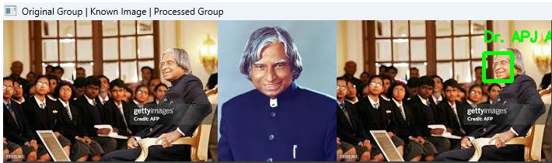

Slide 23
Case Study: Image-Based Disease Diagnosis
Introduction to Image-Based Disease Diagnosis
Image-based disease diagnosis refers to the use of medical imaging techniques to detect, analyze, and diagnose various diseases and health conditions based on images of the body’s internal structures. These diagnostic methods involve capturing high-quality, detailed images using non-invasive imaging technologies, such as X-rays, CT scans, MRIs, ultrasounds, and more recently, advanced modalities like molecular imaging and digital pathology. These images provide vital information about the body’s anatomy and function, allowing healthcare professionals to identify signs of disease, monitor progress, and plan treatment strategies.
The core idea behind image-based disease diagnosis is that visualizing internal organs, tissues, and bones can reveal (expose) underlying issues that may not be visible externally. These diagnostic tools are essential in detecting diseases in their early stages, often before symptoms appear, providing a powerful advantage in the timely treatment and management of health conditions.

Slide 24
Importance of Image-Based Diagnosis:
Early Detection and Prevention: One of the most significant benefits of image-based diagnosis is its ability to detect diseases early, often before symptoms manifest. Early detection of conditions such as cancers, cardiovascular diseases, neurological disorders, and infectious diseases greatly increases the chances of successful treatment. For example, early detection of breast cancer through mammography or early diagnosis of heart disease through CT angiography can help save lives by enabling prompt intervention and preventing complications.
Non-Invasive Approach: Traditional diagnostic methods often require invasive procedures, such as biopsies or surgeries, to obtain tissue samples. In contrast, image-based diagnostics are non-invasive, meaning that they do not require any cutting, puncturing, or tissue removal. This reduces patient discomfort, eliminates the risks associated with surgical procedures, and accelerates the diagnostic process. Non-invasive techniques, such as MRI or ultrasound, can offer comprehensive insights into the body’s condition without exposing patients to unnecessary harm.

Slide 25
Accurate and Detailed Visualization: Medical imaging techniques provide accurate and high-resolution visual representations of the body’s internal structures. These images enable healthcare professionals to pinpoint the location, size, and nature of abnormal growths, fractures, infections, or diseases. The use of CT scans for diagnosing internal bleeding or fractures, MRI scans for identifying tumors, and X-rays for spotting bone conditions are just a few examples of how detailed images can lead to more precise diagnoses.
Guiding Treatment Plans: Medical imaging not only helps in diagnosing diseases but also plays a crucial role in guiding treatment plans. For instance, MRI and CT scans are essential for planning surgical interventions by providing detailed views of organs or areas that need to be treated. Imaging is also critical for radiotherapy planning for cancer treatment, ensuring that radiation is delivered precisely to the affected area while minimizing exposure to healthy tissue.
Monitoring Disease Progression: Image-based diagnostics are also invaluable tools for monitoring the progression of diseases over time. In conditions such as cancer, cardiovascular disease, and neurological disorders, repeated imaging helps doctors track the effectiveness of treatments, detect relapses, and assess how the disease is evolving. For example, regular MRI scans for brain tumors can help doctors assess whether the tumor is shrinking in response to treatment or growing despite it.

Slide 26
Examples of Image-Based Disease Diagnosis:
Cancer Detection: Imaging techniques, particularly mammography and CT scans, are widely used to detect various types of cancer. For example:
Breast Cancer: Mammograms can identify lumps or abnormalities in the breast tissue that might indicate cancer, even before they can be felt physically.
Lung Cancer: Chest X-rays or CT scans help detect abnormal growths or masses in the lungs, which can be early indicators of lung cancer.
Brain Cancer: MRI scans provide detailed images of the brain, helping to identify tumors or abnormal tissue growth.
Cardiovascular Diseases: Diseases of the heart and blood vessels can be diagnosed through advanced imaging techniques:
CT Angiography: This imaging method helps detect blockages or narrowing in the coronary arteries, which may lead to heart attacks or strokes.
Echocardiography: Used to examine the heart’s structure and function, echocardiography can identify issues like heart valve problems, heart failure, or congenital defects.
Cardiac MRI: Used to assess the heart muscle’s function, detect damage after a heart attack, or evaluate congenital heart defects.
Neurological Disorders: Imaging technologies are pivotal in diagnosing and understanding diseases affecting the brain and spinal cord:
MRI and CT Scans: These imaging techniques provide detailed images of the brain, helping to diagnose conditions such as stroke, multiple sclerosis, Alzheimer's disease, and brain tumors.
PET Scans: A type of molecular imaging used in detecting abnormal brain activity in diseases like Parkinson's disease or epilepsy.

Slide 27
Musculoskeletal Diseases: X-rays, MRIs, and CT scans are often used to diagnose conditions affecting the bones, muscles, and joints:
Fractures: X-rays are commonly used to diagnose bone fractures, dislocations, or joint problems.
Osteoarthritis: MRIs and X-rays help diagnose joint deterioration, cartilage loss, and bone changes in diseases like osteoarthritis.
Soft Tissue Injuries: MRI is particularly useful in diagnosing damage to muscles, ligaments, and tendons.
Infectious Diseases: Imaging techniques, especially X-rays and CT scans, can be critical in diagnosing infectious diseases:
Pneumonia: Chest X-rays can reveal fluid in the lungs or other signs of pneumonia.
Tuberculosis (TB): CT scans can identify lung damage caused by TB and help monitor the response to treatment.
Obstetrics and Gynecology: Ultrasound is widely used for prenatal care, providing real-time images of the fetus and detecting potential complications like abnormal growth or congenital defects. It is also used to monitor conditions such as fibroids, cysts, or ovarian cancer in women.
Image-based disease diagnosis is an indispensable tool in modern healthcare. By providing clear, accurate, and detailed images of the body’s internal structures, these technologies help detect diseases early, guide treatment plans, monitor disease progression, and improve overall patient outcomes. With continuous advancements in imaging technologies, such as the integration of AI algorithms, medical imaging is set to become even more precise, efficient, and accessible, further enhancing the ability to diagnose and treat a wide range of diseases.

Slide 28
Techniques
Machine learning: Feature extraction and classification.
Deep learning: CNNs for disease detection.
Example frameworks: TensorFlow, PyTorch.
Method: CNN-based model with high sensitivity and specificity.
Results: Improved early diagnosis and treatment.
Benefits and Challenges
Benefits: Early intervention, reduced costs.
Challenges: Misdiagnosis risk, quality of imaging data.

Slide 29
Example demonstrating Image-Based Disease Diagnosis (Google Colab)
import os
import tensorflow as tf
import cv2
import numpy as np
import matplotlib.pyplot as plt
# Load a lightweight pre-trained model (EfficientNet)
model = tf.keras.applications.EfficientNetB0(weights="imagenet")
# Function to load and preprocess image
def preprocess_image(image_path):
if not os.path.exists(image_path):
print("Error: Image file not found!")
return None
image = cv2.imread(image_path)
if image is None:
print("Error: Unable to read the image. Check file format.")
return None

Slide 30
image = cv2.cvtColor(image, cv2.COLOR_BGR2RGB) # Convert to RGB
image = cv2.resize(image, (224, 224)) # Resize to model input size
image = np.expand_dims(image, axis=0) # Add batch dimension
image = tf.keras.applications.efficientnet.preprocess_input(image)
return image
# Function to predict disease or condition
def predict_disease(image_path):
image = preprocess_image(image_path)
if image is None:
return # Stop execution if image is invalid
predictions = model.predict(image) # Predict class
decoded_predictions = tf.keras.applications.efficientnet.decode_predictions(predictions, top=3)[0]
print("\nPredicted Conditions:")
for i, (imagenet_id, label, score) in enumerate(decoded_predictions):
print(f"{i+1}. {label} ({score:.2f})")

Slide 31
# Function to show image
def show_image(image_path):
image = cv2.imread(image_path)
if image is None:
print("Error: Unable to display image.")
return
image = cv2.cvtColor(image, cv2.COLOR_BGR2RGB)
plt.imshow(image)
plt.axis("off")
plt.show()
# ✅ Fix: Upload or use Google Drive for image path
from google.colab import files
uploaded = files.upload() # Upload image manually
image_path = list(uploaded.keys())[0] # Get uploaded file name
# Show input image
show_image(image_path)
# Predict and diagnose
predict_disease(image_path)

Slide 32
Image-Based Disease Diagnosis.jpg(image/jpeg) - 5446 bytes, last modified: 2/3/2025 - 100% done
Saving Image-Based Disease Diagnosis.jpg to Image-Based Disease Diagnosis (1).jpg
1/1 ━━━━━━━━━━━━━━━━━━━━ 3s 3s/step
Predicted Conditions:
isopod (0.26)
axolotl (0.08)
nematode (0.08)

Slide 33
Image Registration and Image Fusion
Image Registration:
Image registration is the process of aligning two or more images taken from different viewpoints, at different times, or using different sensors, into a common coordinate system. The goal is to match corresponding pixels or regions in the images so that the underlying content is aligned.
Importance of Image Registration:
Multimodal Imaging: In medical imaging, for instance, it allows combining information from different types of scans, such as MRI, CT, or PET scans. This is crucial as each modality highlights different anatomical features or tissue characteristics. Image registration ensures that the data from these scans can be compared or merged.
Change Detection: In remote sensing, image registration is used to align images taken at different times (e.g., satellite images), which helps in detecting changes over time such as land use changes, deforestation, or urban growth.
Enhanced Visual Analysis: Registration is used in computer vision applications, such as object recognition, where combining images from different perspectives can provide a more comprehensive understanding of the scene.
Steps in Image Registration:
Feature Detection: Identifying distinctive points, lines, or regions in the images (e.g., edges, corners, or texture features).
Feature Matching: Finding the corresponding points between the images.
Transformation Estimation: Estimating the transformation (such as translation, rotation, scaling) that aligns the images.
Image Resampling: Applying the transformation to one image to align it with the other.
Validation: Ensuring that the registration is accurate by comparing the results with known ground truth or through error metrics.

Slide 34
Types of Image Registration:
Rigid Registration: Involves transformations that preserve the structure of the image, such as translations, rotations, and scaling.
Non-rigid Registration: Used when there are deformations between images (e.g., organ motion in medical images), requiring more complex transformations, such as elastic or spline-based transformations.
Image Fusion:
Image fusion refers to the process of combining multiple images to create a single image that contains enhanced or more relevant information from each of the original images. The fusion process integrates complementary data from different sources, which may vary in terms of spatial, spectral, or temporal resolution.
Importance of Image Fusion:
Multimodal Imaging: Image fusion is used extensively in medical imaging, where combining different types of scans (such as MRI and CT) helps doctors obtain a more complete and accurate diagnosis.
Remote Sensing: In satellite or aerial imagery, image fusion can combine images from different sensors (e.g., multispectral and panchromatic) to improve the spatial and spectral resolution of the image, making it more useful for tasks such as vegetation analysis or land cover classification.
Improved Visual Interpretation: By merging data from different perspectives or under different conditions (such as day and night), image fusion enhances the clarity and information content, which is particularly useful in surveillance, security, and autonomous driving systems.
Noise Reduction: Fusion techniques can also help in reducing noise and improving image quality by combining data from multiple sources to mitigate the effects of noise in individual images.

Slide 35
Types of Image Fusion:
Pixel-level Fusion: Involves directly combining pixel values from different images. This method is often used when images are aligned and share the same spatial resolution. Techniques include:
Simple Averaging: Combining images by averaging pixel values.
Principal Component Analysis (PCA): Reduces dimensionality by extracting the most significant features and merging them.
Wavelet Transform: Decomposes images into frequency components for fusion.
Feature-level Fusion: Involves extracting features (such as edges, textures, or keypoints) from different images and combining them. This method is useful when the images vary in resolution, viewpoint, or content.
Decision-level Fusion: Involves combining the outputs of different classifiers or decision processes based on multiple image inputs. This is commonly used in object detection or recognition tasks.
Fusion Techniques:
Multi-sensor Fusion: Combining images from different sensors with varying spectral and spatial resolutions.
Multi-temporal Fusion: Combining images from different time periods to track changes over time.
Multiview Fusion: Combining images captured from different angles or viewpoints, commonly used in 3D reconstruction and object recognition.
Deep Learning-based Fusion: Recent advances in neural networks allow learning-based methods for image fusion, which can combine images in a more adaptive and intelligent manner by learning the best fusion strategy based on the image content.

Slide 36
Applications of Image Registration and Image Fusion:
Medical Imaging:
Image Registration: Registration of different imaging modalities (CT, MRI, PET, etc.) allows for comprehensive 3D visualizations of anatomical structures. For instance, MRI can capture soft tissues, while CT scans provide detailed bone structures. When combined, doctors can make more informed decisions.
Image Fusion: For example, fusing PET and CT images allows oncologists to visualize both the anatomical location of tumors (CT) and metabolic activity (PET), improving diagnosis and treatment planning.
Remote Sensing:
Image Registration: Satellite images taken from different angles or at different times need to be aligned to monitor environmental changes, such as deforestation, urbanization, or crop health.
Image Fusion: By combining high-resolution panchromatic images with multispectral images, we can improve the spatial resolution of the image while retaining valuable spectral information, useful for vegetation analysis, land classification, and environmental monitoring.
3. Computer Vision and Robotics:
Image Registration: In autonomous vehicles, registration of images from multiple cameras or sensors is critical for accurate object detection and navigation, especially in complex environments.
Image Fusion: Combining data from LiDAR and camera systems allows for precise 3D mapping, helping robots and autonomous vehicles to understand their surroundings better.

Slide 37
Image Registration
Methods: Feature-based, intensity-based.
Applications: Pre- and post-operative scans.
Image Fusion
Levels: Pixel, feature, and decision-level fusion.
Applications: PET-MRI fusion for enhanced diagnostics.
Method: Multi-resolution fusion using wavelet transforms.
Results: Improved diagnostic accuracy.
Challenges and Future Trends
Challenges: Misalignment, computational cost.
Trends: AI-powered fusion techniques.

Slide 38
Example demonstrating Image Registration and Fusion
import cv2
import numpy as np
def image_registration_ecc(img1, img2):
# Convert images to grayscale
gray1 = cv2.cvtColor(img1, cv2.COLOR_BGR2GRAY)
gray2 = cv2.cvtColor(img2, cv2.COLOR_BGR2GRAY)
# Define warp mode (Affine transformation for registration)
warp_mode = cv2.MOTION_AFFINE
warp_matrix = np.eye(2, 3, dtype=np.float32)
# Set termination criteria (iterations, epsilon)
criteria = (cv2.TERM_CRITERIA_EPS | cv2.TERM_CRITERIA_COUNT, 50, 1e-6)

Slide 39
# Apply ECC-based image alignment
try:
_, warp_matrix = cv2.findTransformECC(gray1, gray2, warp_matrix, warp_mode, criteria)
except:
print("Error: ECC registration failed.")
return None
# Apply warp transformation
registered_img2 = cv2.warpAffine(img2, warp_matrix, (img1.shape[1], img1.shape[0]), flags=cv2.INTER_LINEAR)
return registered_img2
def image_fusion(img1, img2):
# Weighted average fusion
fused_image = cv2.addWeighted(img1, 0.5, img2, 0.5, 0)
return fused_image

Slide 40
# Check if images are loaded
if img1 is None or img2 is None:
print("Error: Could not load images. Check file paths.")
return
# Perform image registration using ECC
registered_img2 = image_registration_ecc(img1, img2)
if registered_img2 is None:
print("Image registration failed. Exiting.")
return
# Perform image fusion
fused_image = image_fusion(img1, registered_img2)
def main():
# Load two images
img1_path = 'E:\\Bharti\\DIP & A IInd Sem\\image1.jpg'
img2_path = 'E:\\Bharti\\DIP & A IInd Sem\\image2.jpg'
img1 = cv2.imread(img1_path)
img2 = cv2.imread(img2_path)
# Display results
cv2.imshow('Registered Image 2', registered_img2)
cv2.imshow('Fused Image', fused_image)
cv2.waitKey(0)
cv2.destroyAllWindows()
# Save results only if successful
cv2.imwrite('registered_image2.jpg', registered_img2)
cv2.imwrite('fused_image.jpg', fused_image)
print("Images saved successfully!")
if __name__ == "__main__":
main()

Slide 41


Output
Registered Image
Fused Image

Slide 42
Discussion

Slide 43
Thank you

